Slide 1
Knowing an Object by the Company It Keeps: A Domain-Agnostic Scheme for Similarity Discovery
Olof Görnerup, Daniel Gillblad and Theodore Vasiloudis
Decisions, Networks and Analytics Lab
Swedish Institute of Computer Science (SICS)
ICDM 2015, November 17

Slide 2
Similarity

Slide 3
Objects

Slide 4
Objects
People, words, proteins, system states, …

Slide 5
Objects and correlations
People, words, proteins, system states, …
Friendships, co-occurrences, interactions, transitions, …

Slide 6
Similarity?

Slide 7
You shall know a word by the company it keeps.
- J. R. Firth, 1957

Slide 8
You shall know a word by the company it keeps.
an object

Slide 9
Object with company

Slide 10
Object with company

Slide 11
Object in context

Slide 12
Similar objects have similar contexts

Slide 13
Similar objects have similar contexts
Similar objects are exchangeable

Slide 14
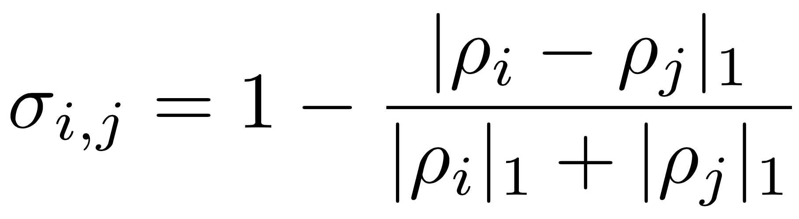
Similar objects have similar contexts
Similar objects are exchangeable

Slide 15
Calculating similarities
Similar objects are one neighbour apart

Slide 16
Calculating similarities
Compare edges to shared neighbours

Slide 17
Calculating similarities
Transform to two-hop graph

Slide 18
Calculating similarities
Transform to two-hop graph

Slide 19
Calculating similarities
Correlation graph

Slide 20
Calculating similarities
Correlation graph
Similarity graph

Slide 21
Calculating similarities

Slide 22
First example: Computational linguistics

Slide 23
Second example: Music

Slide 24
Third example: Molecular biology

Slide 25
Discovering concepts
Concept = group of inter-similar objects

Slide 26
Discovering concepts
Concept = group of inter-similar objects
Cluster objects in the similarity graph

Slide 27
Discovering concepts
Concept = group of inter-similar objects
Cluster objects in the similarity graph
Algorithm based on SLPA by Xie et al.

Slide 28
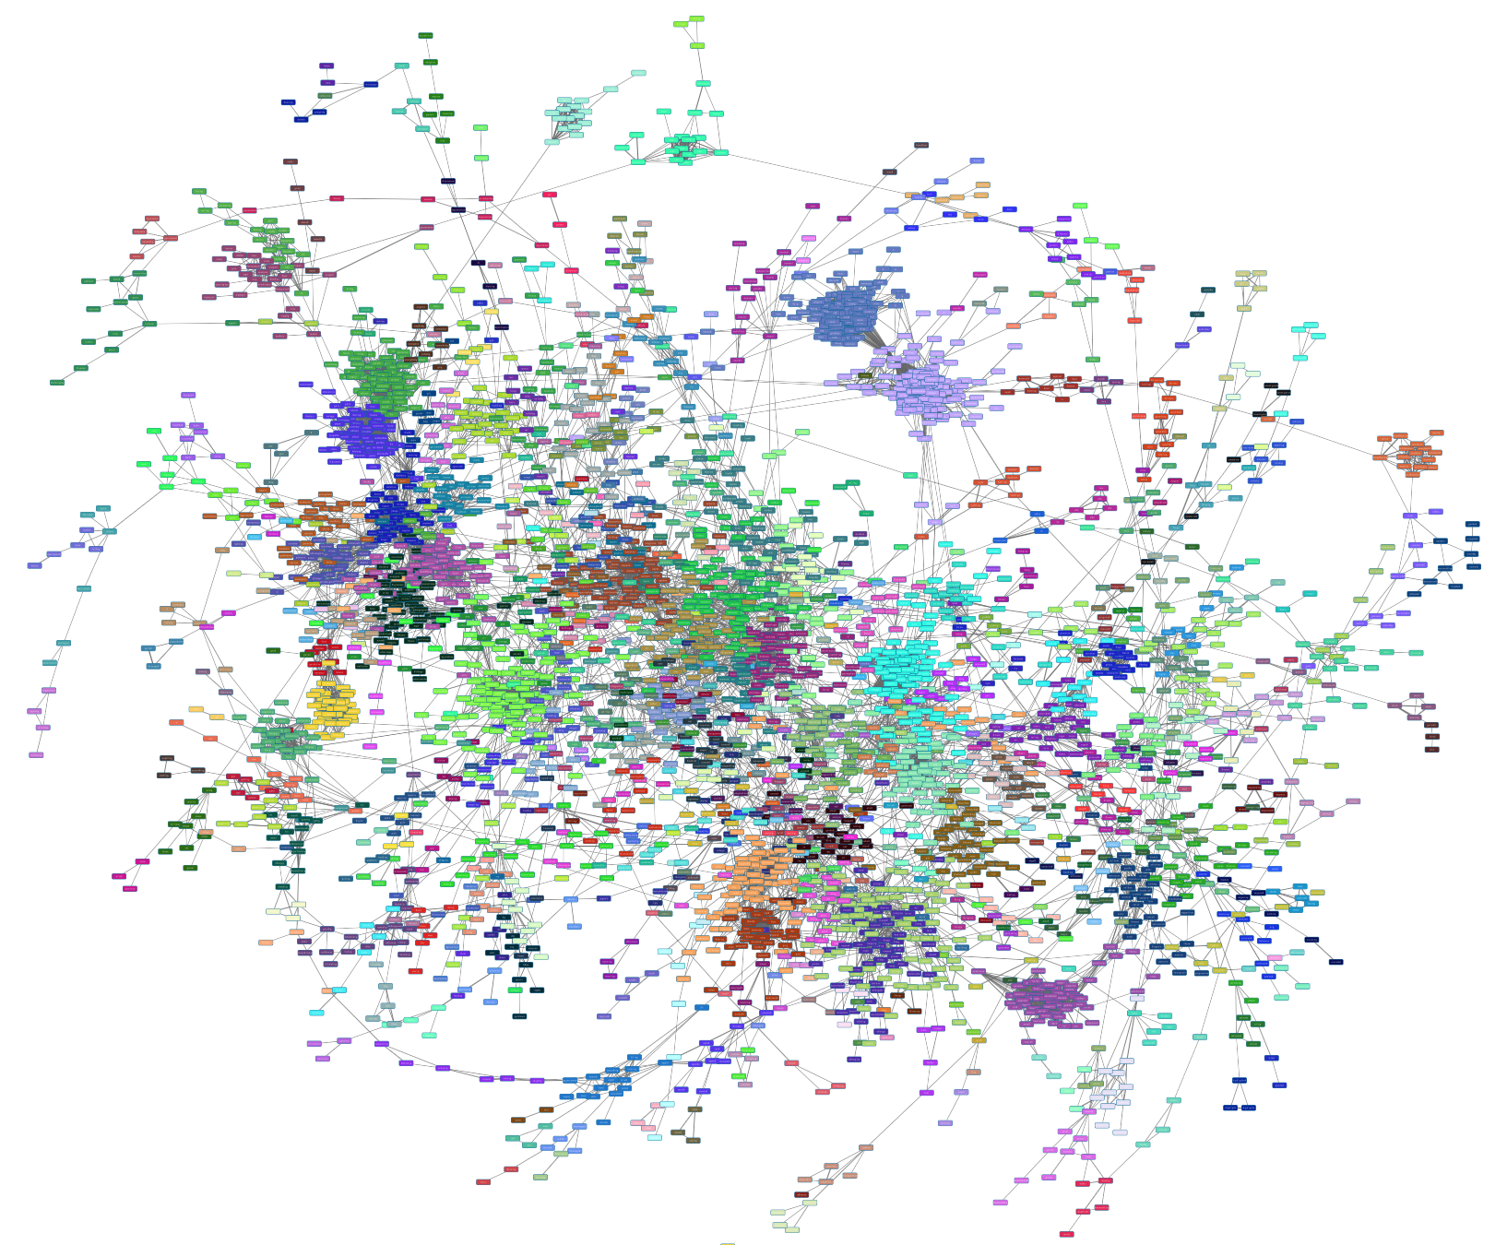

Slide 29
Example concepts

Slide 30
Scalability
Locality: Similar objects are close in the graph
Sparseness: Most objects are unrelated

Slide 31
Scalability
Locality + Sparseness = Scalability
Billion words on laptop
Google books on Amazon EC2

Slide 32
Future work
Apply

Slide 33
Future work
Apply
on gene regulatory data

Slide 34
Future work
Apply
on gene regulatory data
on protein interaction networks

Slide 35
Future work
Apply
on gene regulatory data
on protein interaction networks
as recommendation system

Slide 36
Future work
Apply
on gene regulatory data
on protein interaction networks
as recommendation system
to find higher-order dynamics …

Slide 37
Thank you!
Contact: {olof, dgi, tvas}@sics.se

